Slide 1

Domain-driven design With Clean Architecture
In A Nutshell
Don't Forget To Subscribe!
Source Code: https://bit.ly/your-source

Slide 2
Domain-Driven Design Concepts

Slide 3
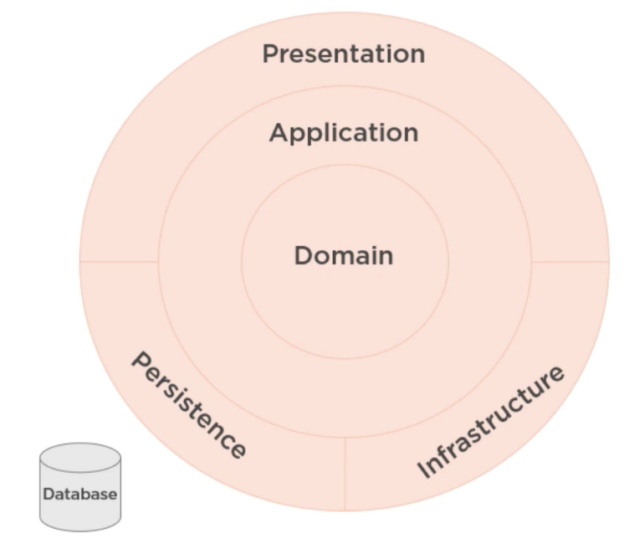
Domain-Driven Design
Business domain comes first
You do not care about the database
It is just a detail
You do not care about the presentation
We communicate with domain experts to design
A history of success with complex projects
Steps are:
Solve problems, understand client needs, and then write the code!

Slide 4
Benefits
Very flexible
Customer’s vision/perspective of the problem
Path through a very complex problem
Well-organized and easily tested code
Business logic lives in one place
Many great patterns to leverage

Slide 5
Drawbacks
Time and Effort
Discuss & model the problem with domain experts
Isolate domain logic from other parts of application
Learning curve (why this workshop was a success)
New principles
New patterns
New processes
Only makes sense when there is complexity in the problem
Not just CRUD or data-driven applications
Not just technical complexity without business domain complexity

Slide 6
Mentorship program ON Patreon
These videos are part of my mentoring program!
More information on Patreon: https://www.patreon.com/ivaylokenov
Target – junior to regular programmers with 0 to 2 years practical work
Help with:
Becoming better software developers
Code improvement in terms of quality and logic
Career choices and advancement
Interview preparation
And more
Approach – private groups, exclusive lessons, workshops, one-on-one meetings
Data structure performance, architecture

Slide 7
DOMAIN-DRIVEN design IS SUPERIOR
Pros
Scalable in terms of development
Code has even better separation
It covers all our architecture needs
Improved patterns and flexibility
Cons
Usable when the business logic is complex
Time-consuming as it needs more classes and relationships between them

Slide 8
Domain-driven design is about code
Writing code is only part of the solution
We need to speak to domain experts
And use the same language in our code
Our domain model should “scream” the business requirements
Our classes and methods should describe the actual process

Slide 9



Any Questions?
Leave A Comment Below!
Don't Forget To Like The Video!

